Slide 1
C/C++ Programming Tools
Parallel Programming Lab2

Slide 2


Compilers
GCC family
gcc
g++
LLVM/Clang family
clang
clang++

Slide 3
GCC vs Clang
They have mostly the same usage
Flags (options) supported on one should mostly work out-of-the-box on the other
Initially Clang put a lot of effort on providing better error messages, and but now GCC has catched on
I suggest you try to use Clang if you cannot understand GCC’s error messages, and vice versa.
Also they sometimes produce faster executables than each other.

Slide 4
MPI Compiler Wrapper
mpicc calls gcc under the hood
mpicxx calls g++ under the hood
To use mpicc with clang, call mpicc -cc=clang
To use mpicxx with clang++, call mpicxx -cxx=clang++

Slide 5
GCC/Clang optimization flags
-O2
Turns on most optimizations
-O3
Turns on all optimizations in -O2, plus optimizations that trade off code size for execution time
https://gcc.gnu.org/onlinedocs/gcc/Optimize-Options.html

Slide 6
GCC/Clang other flags
-lXXX Link the XXX library. For example, -lm links the math library libm.so mpicc automatically adds -lmpi for you
-o XXX Set the output executable filename to XXX
-g Generate debug information

Slide 7
Makefile

Slide 8
Makefile
We acknowledge make is not a good build system
But it’s most commonly used / known
So as an unfortunate outcome, we still use Makefiles
We ask you to submit Makefiles in homeworks because we encourage you to try different compiler options

Slide 9
Makefile: a very brief introduction
Used to tell the make command how to build executables from sources.

Slide 10
Example
.PHONY: all all: hello world
.PHONY: clean clean: rm -f hello world
hello: hello.c gcc -o hello -O3 -g hello.c
world: world.c gcc -o world -O3 -g world.c

Slide 11
Example
TARGETS = hello world
.PHONY: all all: $(TARGETS)
.PHONY: clean clean: rm -f $(TARGETS)
%: %.c gcc -o $@ -O3 -g $^

Slide 12
Example
TARGETS = hello world CFLAGS = -O3 -g
.PHONY: all all: $(TARGETS)
.PHONY: clean clean: rm -f $(TARGETS)
%: %.c $(CC) -o $@ $(CFLAGS) $^

Slide 13
Example
TARGETS = hello world CFLAGS = -O3 -g
.PHONY: all all: $(TARGETS)
.PHONY: clean clean: rm -f $(TARGETS)

Slide 14
Any questions about Makefiles?

Slide 15
2. Tools

Slide 16
Tools
Turn on compiler warnings
Clang static analyzer
AddressSanitizer
gdb
Using this in parallel environments is super complex so we’re not going to cover it

Slide 17
Turn on compiler warnings
Just add -Wall to the list of compiler flags

Slide 18
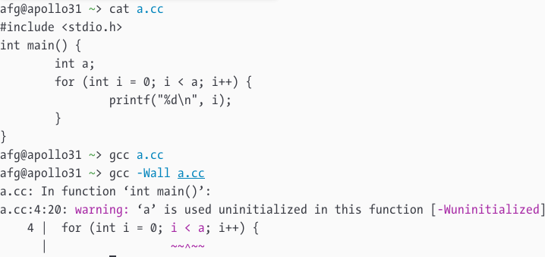
Compiler warnings off vs on

Slide 19
Clang static analyzer
Perform more complex compile-time static analysis than -Wall

Slide 20
Clang static analyzer: usage
Use one of the following
Compile with clang --analyze
Use scan-build -o outputpath make instead of make
Then, you can either:
Run scan-view --host 0.0.0.0 --allow-all-host outputpath/XXX
Or download outputpath/XXX and view locally

Slide 21
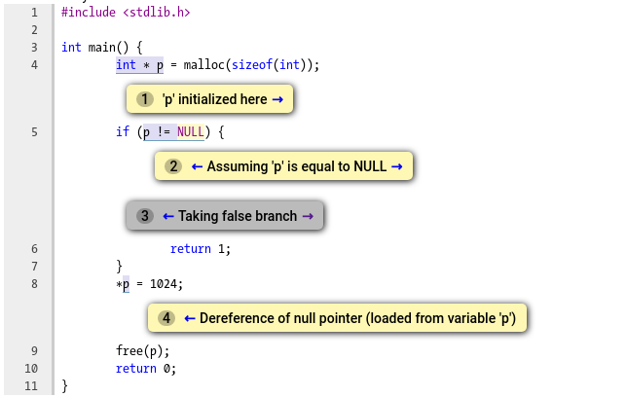

Slide 22
AddressSanitizer
Asks the compiler to inject code to check memory access during execution.
https://github.com/google/sanitizers/wiki/AddressSanitizer

Slide 23
AddressSanitizer
Add -fsanitize=address -g to the compiler. Then run your code as usual. Asan will crash your program if something wrong happened.
AddressSanitizer works with either GCC or Clang.
Enabling Asan would harm performance! Only use it for debugging, don’t submit your code with Asan enabled.

Slide 24
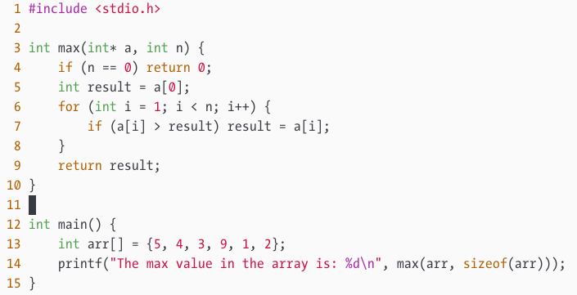

Slide 25
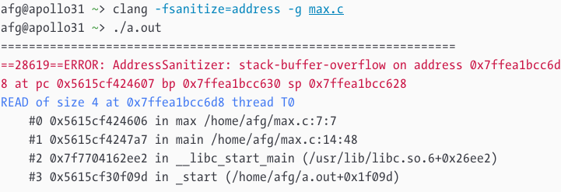

Slide 27
Task

Slide 28
Lab2 Task
There is a sequential odd-even sort program at /home/pp19/share/lab2/oe.c, with a bug, use AddressSanitizer to find and fix the bug.
Submit a report (PDF) on iLMS, describing how you find the bug with AddressSanitizer. Screenshots with short descriptions is enough.
You do not need to submit the fixed code.

